Slide 1

Building a Real-Time Flight Map with Azure Maps, Azure Functions, Cosmos DB & SignalR
Dave Theunissen
Auckland Azure Global Bootcamp 2019
@davetheunissen

Slide 2

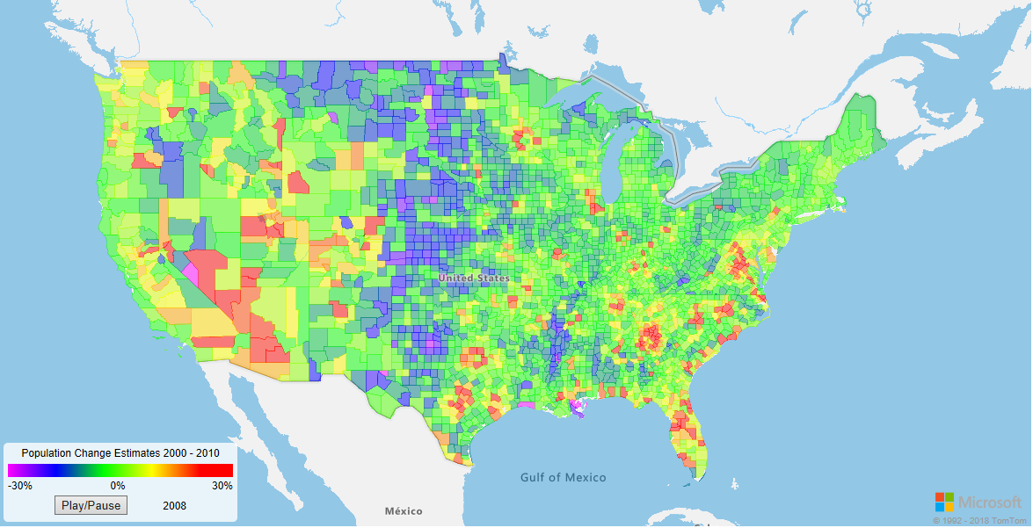
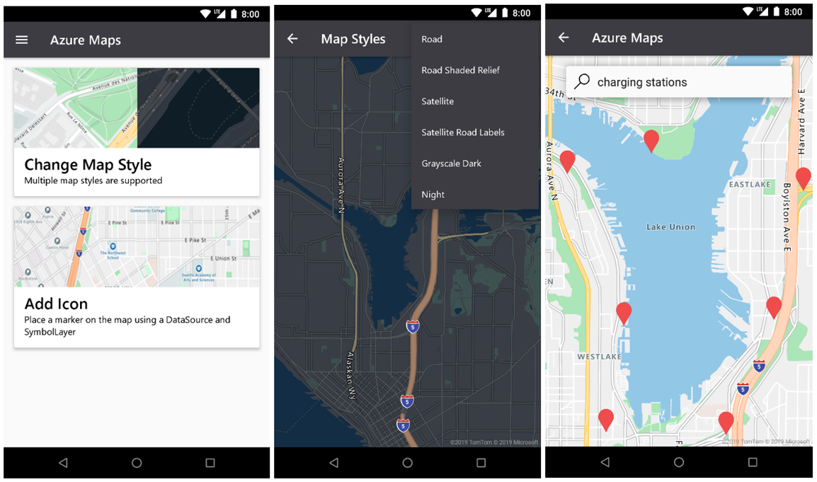
Azure Maps
Azure Maps is a portfolio of geospatial service APIs that enable developers to create location aware solutions.
Android SDK
Geospatial Imaging

Slide 3

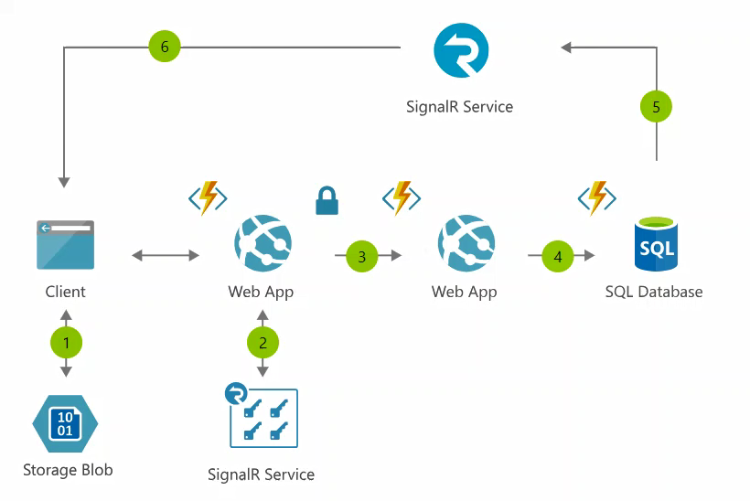
Azure SignalR
Azure SignalR Service enables developers to quickly and easily add real-time two way communication to their web apps over HTTP without the nee to refresh the client or poll the server.

Slide 4

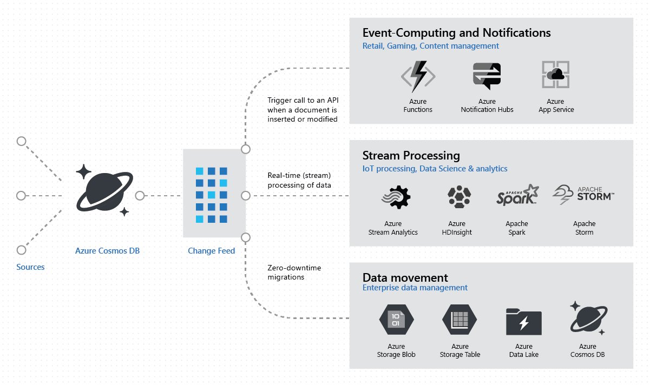
Azure Cosmos DB
Azure Cosmos DB is a globally distributed and highly available multi-model database “for managing data at planet scale”.

Slide 5

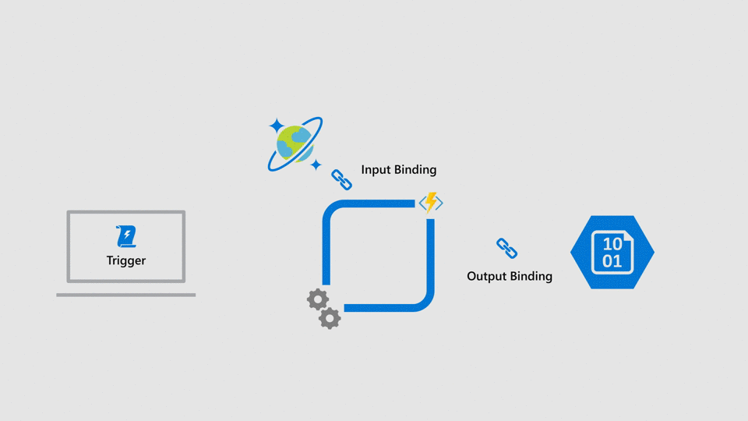
Azure Functions
Azure Functions provide a platform for event driven serverless compute.
Input Bindings
Output Bindings
Triggers

Slide 6
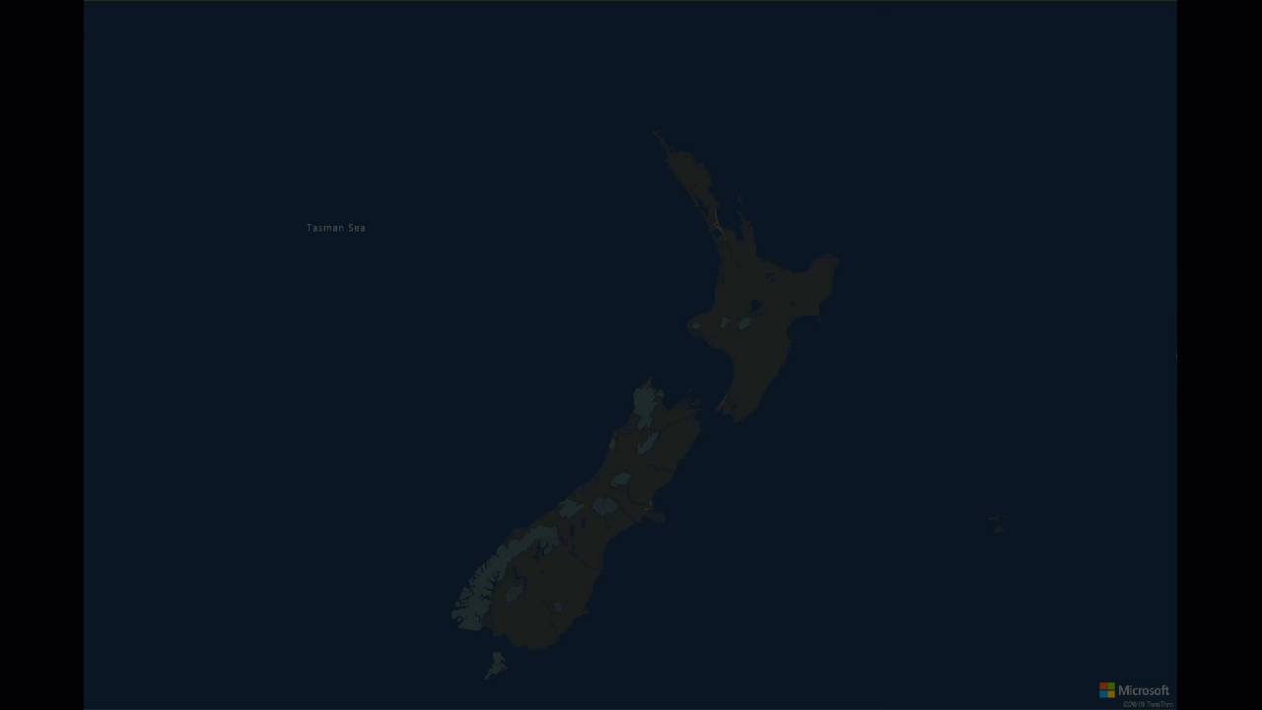
What are we going to build?
https://dtflightappgsa.z19.web.core.windows.net/index-signalr.html

Slide 7


Application Flow @ 10,000ft
Azure Cosmos DB
Browser
Desktop App
Mobile App
Game
Changes
Collection
1
Azure Functions
Azure SignalR
Service
2
Change Feed
3
4
5
Cosmos DB trigger
SignalR output binding
WebSockets

